Slide 1

Chapter 17
The Need for HTML 5

Slide 2
Learning Objectives
How HTML 5 has been under development since the late 1990s
How HTML 5 introduces support for mobile devices, such as geopositioning
How HTML 5 makes it easier for developers to integrate video and audio into a webpage
How HTML 5 provides a canvas region within a webpage where developers can use JavaScript to code dynamic graphics operations
How HTML 5, to improve the user interface, supports drag-and-drop operations
How HTML 5 provides support for multitasking within a webpage through the use of JavaScript code that implements a specific task
How HTML 5 provides session-based storage and longer-term storage, using 5MB capacity objects that are similar in concept to client-side cookies
How HTML 5 provides support for Web sockets, which support text-based communication between users within a webpage
How HTML 5 provides support for new tags, which provide greater document-like structure and data semantics

Slide 3
Understanding the Need for HTML 5
HTML, as you have learned, is the hypertext markup language developers use to create webpages. Since HTML Version 1, developers have made enhancements to HTML by adding tags, removing or depreciating other tags, adding properties, and so on. In this way, HTML 5 is, in one sense, simply a step in the evolutionary process of HTML. That said, HTML supports some very powerful new capabilities, which the sections that follow will introduce.

Slide 4
Support for Mobile Devices
Today, use of the World Wide Web on mobile devices is exploding. HTML 5 was designed with mobile phones and hand-held tablet devices in mind.
For example, using HTML 5, developers can create animations that previously required the use of Flash technology, which many hand-held devices do not support.
In addition, HTML 5 provides support for geopositioning, which applications can use to determine a user’s location and provide “location aware” content, such as driving directions or advertisements for nearby restaurants and retailers.

Slide 5
Improved Support for Audio and Video
Websites today make extensive use of media, such as videos and audio podcasts. For years, to simplify the process of working with video, developers simply uploaded their videos to sites such as YouTube and then embedded links to those videos into the pages they create. In this way, the developers shift the underlying complexity of video integration to YouTube.
HTML provides more support and new tags for video and audio. Chapter 18, “Integrating Audio and Video,” examines HTML 5 support for video and audio in detail. As you will learn, HTML 5 makes video and audio processing better, but not perfect. Integrating video into pages that support a wide range of browsers can still be challenging.

Slide 6
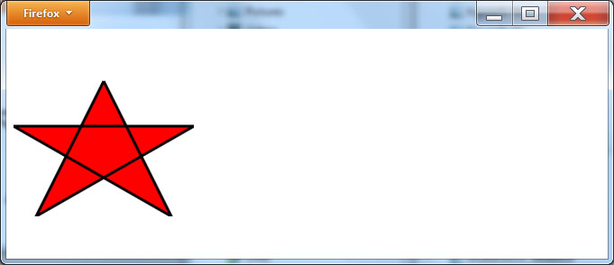
Canvas Programming
As webpages become more complex, Web developers need a way to create dynamic graphics, such as dashboards, charts, and animations. As shown, HTML 5 provides a canvas region that JavaScript programmers can use for the display of 2D images, photos, and text.

Slide 7
Enhanced Client-Side Storage Capabilities
For years, developers made extensive use of client-side cookies to store information about user preferences, shopping-cart entries, and more. Using a cookie, websites can store up to 4KB of data.
HTML 5 provides the ability for users to store much, much more data, up to 5MB using a sessionStorage object and a localStorage object.
The sessionStorage object stores data for the duration of a user’s session interaction with a page. The localStorage object stores data until the application or the user delete the object.

Slide 8
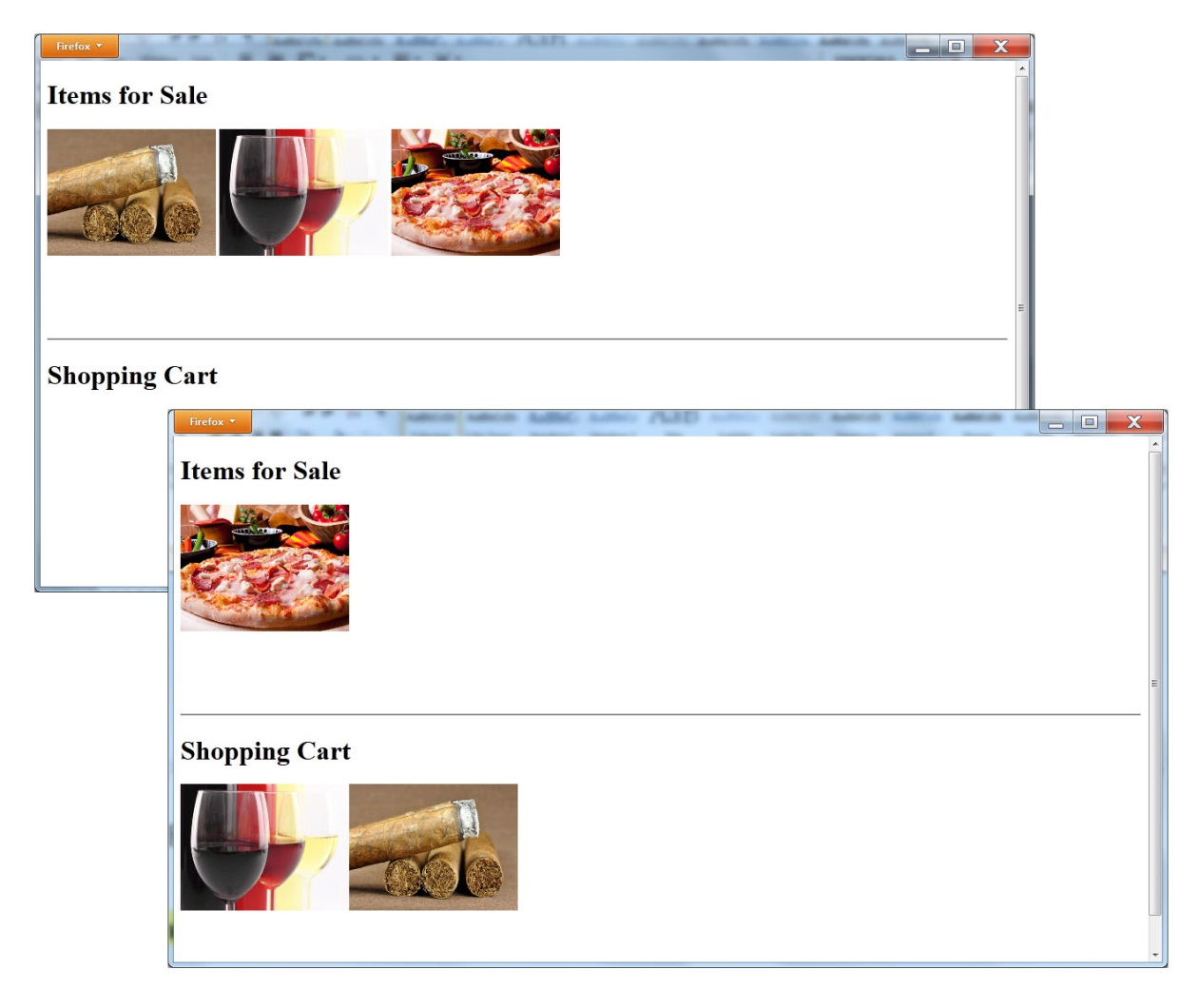
Support for Drag-and-Drop Operations
Web developers should always look for ways to improve a site’s user interface and opportunities for a more natural interaction. To that end, HTML 5 provides, as shown, support for drag-and-drop operations. Using a drag-and-drop operation, for example, your webpage might allow a user to drag items into a shopping cart.

Slide 9
Multi-tasking with Web Workers
As you know, operating systems, such as Windows, allow users to run multiple programs at the same time.
Many of the programs can perform their processing in the background, while the user works actively with a different window.
Depending on the processing a webpage performs, there may be times when you will need the page to perform background processing, such as updating images while users perform other tasks on the page.
To perform such background tasks within a webpage, you can use HTML 5 web workers.

Slide 10
Communication with web sockets
Across the Internet, users make extensive use of texting and instant messaging to perform text-based communication with other users. To help Web developers integrate such chat capabilities into the webpages they create, HTML 5 supports the use of Web sockets.

Slide 11
HTML 5 Document Structure and Page Semantics
Many HTML pages now display content similar in form to a document’s structure, meaning, the pages have a header, content, a footer, figures, sidebars, and more. To make it easy for developers to format such content consistently, HTML 5 provides several new document-structure tags as well as several new semantic tags.

Slide 12
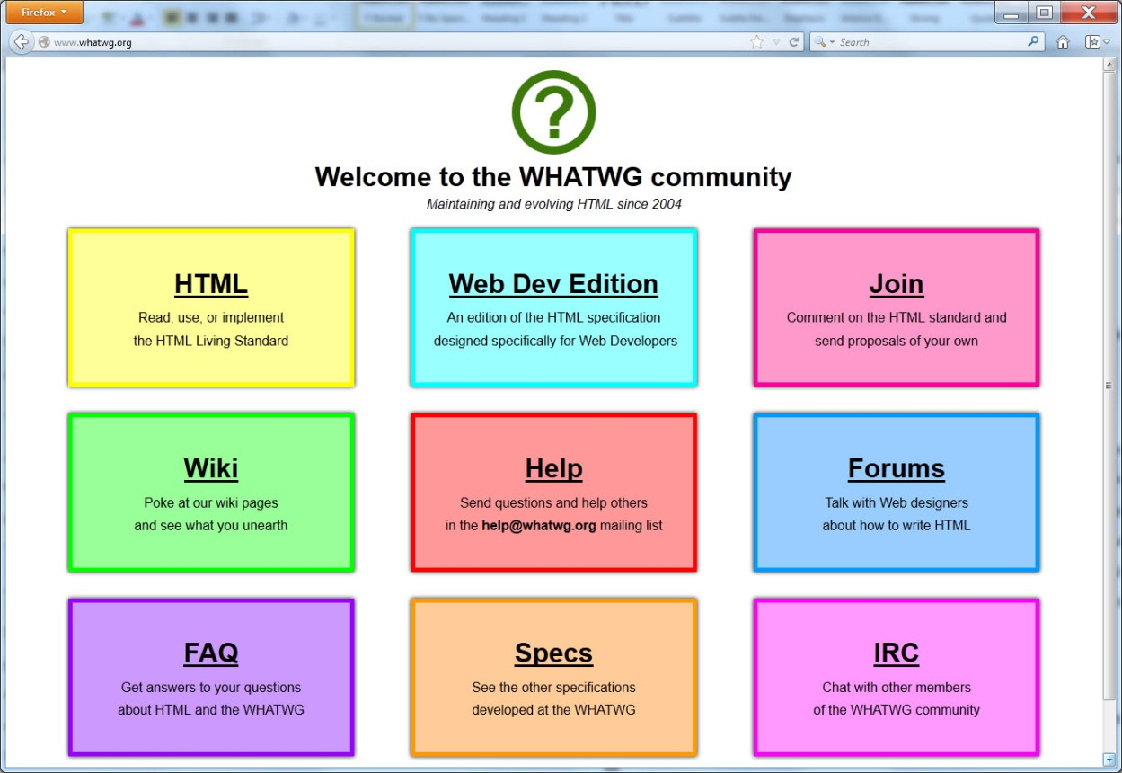
Real world: The WhatWG.org website monitors HTML 5 specification issues

Slide 13
summary
HTML 5 is the newest evolution of the hypertext markup language that developers use to create webpages.
HTML 5, like most major releases of HTML, adds some new tags while deprecating others.
Some of the key features of HTML 5 include improved support for video and audio integration, tags to assist in formatting document-like pages that use headers, footers, and sidebars, support for drag-and-drop operations, text-based communication, and multi-tasking through the use of Web workers.

